Slide 1
Welcome to the Lead IDEA Solution-Based Learning Series
Learning Block 2: You're at the Table—
Now What? Understanding the Role of
the LEA Representative in IEP Meetings
April 9, 2026
This material was produced under the U.S. Department of Education, Office of Special Education Programs, Award
No. H325Z230007. Anna Macedonia serves as the project officer. The views expressed herein do not necessarily represent the positions or policies of the U.S. Department of Education. No official endorsement by the U.S. Department of Education of any product, commodity, service, or enterprise mentioned on this website is intended or should be inferred.

Slide 2
Virtual Meeting/Conference Recording Notice
The American Institutes for Research® (AIR®) allows for the recording of audio, visuals, participants, and other information sent, verbalized, or utilized during business-related meetings. By joining a meeting, you automatically consent to such recordings. Any participant who prefers to participate via audio only should disable their video camera so only their audio will be captured. External AI bots are prohibited unless specifically authorized. Video and/or audio recordings of any AIR session shall not be transmitted to an external third party without the permission of AIR.
​

Slide 3
Welcome to the Lead IDEA Solution-Based Learning Series
Learning Block 2: You're at the Table—
Now What? Understanding the Role of
the LEA Representative in IEP Meetings
April 9, 2026
This material was produced under the U.S. Department of Education, Office of Special Education Programs, Award
No. H325Z230007. Anna Macedonia serves as the project officer. The views expressed herein do not necessarily represent the positions or policies of the U.S. Department of Education. No official endorsement by the U.S. Department of Education of any product, commodity, service, or enterprise mentioned on this website is intended or should be inferred.

Slide 4
Agenda
1
Welcome to the Lead IDEA Solution-Based Learning Series
2
IDEA Foundations: Legal Responsibilities
3
Common Obstacles and Challenges
4
Strategies to Address Challenges and Ensure High-Quality IEP Development
5
Application and Reflection Activity
6
Closing and Next Steps

Slide 5

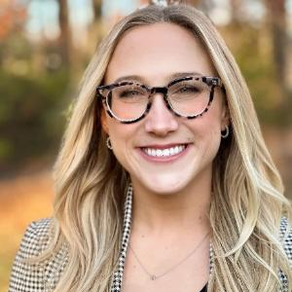
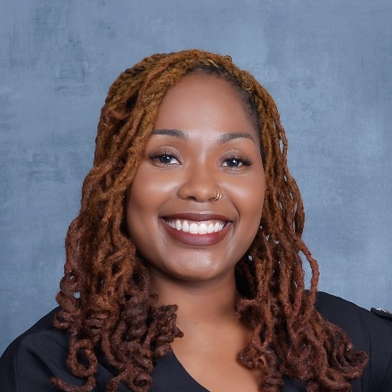
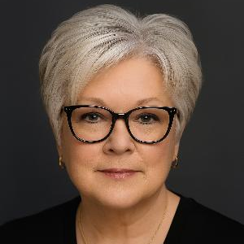
Meet the Lead IDEA Presenters
Paul Steinle, Ph.D.
Jenna Basile, Ph.D.
Timara Davis, Ph.D.
Karen Shaffer, M.Ed.
Technical Assistance Provider
American Institutes for Research
Technical Assistance Provider
American Institutes for Research
Technical Assistance Provider
American Institutes for Research
Technical Assistance Provider
Boston University

Slide 6
Today's Norms
Honor Strengths and Differences: Recognize and value the experiences, perspectives, and expertise participants bring to the table.
Engage Actively and Respectfully: Listen with intention, speak with purpose, and contribute constructively to foster a collaborative environment.
Assume Positive Intent: Approach discussions with curiosity and compassion to promote a safe space for learning and sharing.
Stay Solution-Focused: Prioritize actionable feedback and ideas that support continuous improvement of tools and understanding of the Individuals with Disabilities Education Act (IDEA).
Share the Mic: Balance participation to ensure that all voices are heard
and valued.

Slide 7
Solution-Based Learning Series Timeline
April 9, 2026 | Independent Work | April 23, 2026
Virtual Session |  | Virtual Session
Knowledge Development Session 75 minutes 6:00–7:15 p.m. ET |  | Reflection Session 60 minutes 6:00–7:00 p.m. ET

Slide 8
Goal
By the end of this learning series, participants will be able to:
Clarify principals' legal responsibilities when serving as or supporting the local educational agency (LEA) representative under IDEA.
Reflect on current leadership practices related to participation in individualized education program (IEP) meetings.
Identify common leadership challenges and decision-making pitfalls that occur during IEP meetings.
Develop and demonstrate leadership strategies that support effective LEA participation and high-quality IEP development.

Slide 9



Who Are We? The Lead IDEA Center
We work with leaders to improve systems serving children
with disabilities and their families through effective implementation of
the Individuals with Disabilities Education Act (IDEA).
Knowledge Advancement
Capacity Building
Infrastructure Development
Partnership, Local Collaboration, Innovation, Continuous Improvement
9

Slide 10
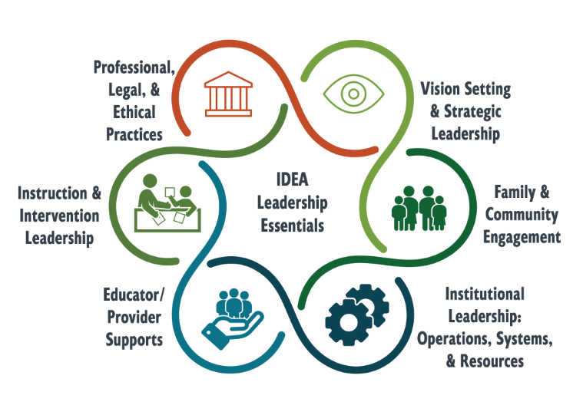

The IDEA Leadership Essentials
Each “essential” includes:
  Action-oriented statement
  Core mindset
  Indicators of success
https://bit.ly/LeadEss

Slide 11
Goal of Learning Block
The goal of the Lead IDEA Solution‑Based Learning Series Learning Block 2 is to strengthen principals' understanding of their legal responsibility to serve as or designate a prepared LEA representative in IEP meetings.

Slide 12
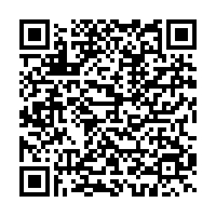
LEA Representative Defined
Poll: Who currently serves as the LEA representative in your school/district?
What is an LEA representative?
  An LEA representative is a district's authorized decision-maker in the IEP process.

Slide 13
Who is most likely to serve as the LEA representative?
Principal
Assistant principal
Special education director
Curriculum director
Director of student services
Dean of students
Building-level special education administrator

Slide 14
IDEA Foundations:
Legal Responsibilities

Slide 15
What IDEA Requires of the LEA Representative
Under IDEA (34 C.F.R. §300.321(a)(4)), the LEA representative must:
Be knowledgeable about the general education curriculum
Be knowledgeable about the public agency's available resources
Be qualified to provide or supervise specially designed instruction
Source: https://sites.ed.gov/idea/regs/b/d/300.321

Slide 16
An LEA Representative’s Actions…
Integrate all IEP team member's perspectives into IEP decisions to support access and progress in the general curriculum
Apply knowledge of both special education and general education to ensure decisions are instructionally sound and aligned with curriculum standards
Understand district programs, staffing, and resource availability—and be able to authorize them to ensure high-quality implementation of the IEP
Have the LEA’s permission to commit services and resources on behalf of the district during the IEP meeting

Slide 17
What roles do LEA representatives play in meetings?
Educational Leader
Collaborative Team Member
Knowledge Expert
Decision-Maker
  Guides the
  team in IEP development.
  Participates actively in IEP discussion.
  Brings awareness of and influence on systems that support IEP implementation.
  Has the authority to commit services and supports on behalf of the district.

Slide 18
The Principal's Role
Principals are responsible for ensuring that:
An appropriate LEA representative attends each IEP meeting.
The LEA representative understands their legal role and authority.
Decisions made in IEP meetings are high quality, compliant, and implementable.
A system is in place to support consistent LEA preparation and follow‑through related to staffing, services, and resources required to implement the IEP.

Slide 19
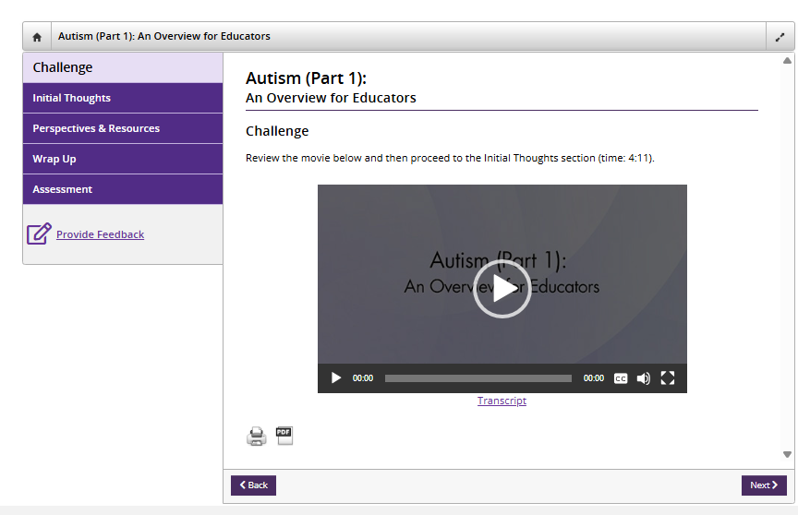

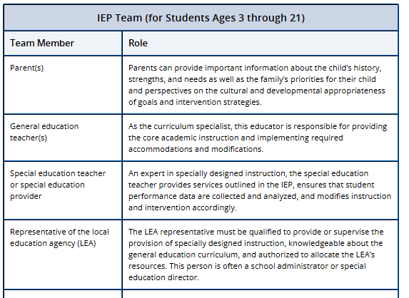
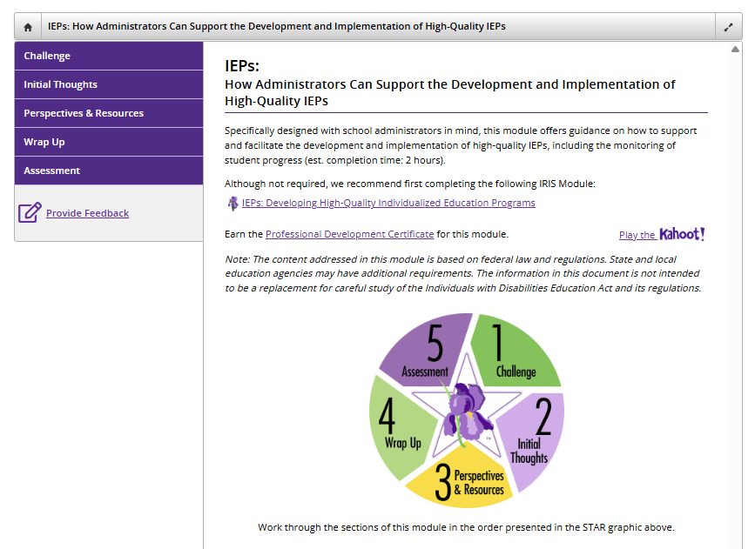
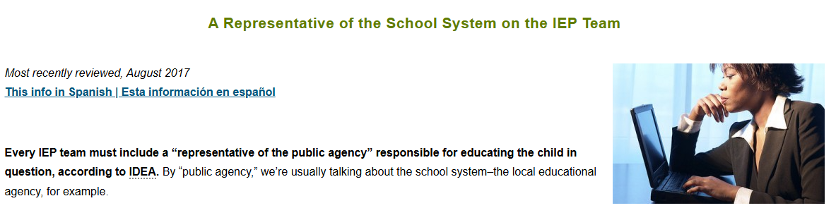



LEA Representative Resources
IRIS Center: The Multidisciplinary Team
IRIS Center: How Admin Can Support the Development and Implementation of High-Quality IEPs
CPIR: A Representative of the School System on the IEP Team

Slide 20
Common Obstacles and Challenges

Slide 21
Common Challenges Leaders Experience as the LEA Representative
Preparedness: Limited readiness to discuss services, resources, or decision‑making authority
Data use: Insufficient access to or use of meaningful student data
Navigating conflict: Difficulty managing disagreement and addressing family concerns
Content knowledge: Gaps in understanding specially designed instruction (SDI) and related services

Slide 22
Common Challenges Leaders Experience as the LEA Representative (Continued)
Prescriptiveness: Over‑reliance on scripted or predetermined proposals
Compliance vs. collaboration: Tension between legal requirements and real‑time problem‑solving
Communication gaps: Limited coordination across general education, special education, and related services
Operational insight: Insufficient access to staffing, scheduling, and resource information

Slide 23
Chat Activity
Think of the last IEP meeting where you served as the LEA representative.
  What made your role easy?
  What made your role challenging?
Which of these eight common challenges limits your effectiveness as an LEA representative?
Preparedness
Data Use
Navigating conflict
Content knowledge
Prescriptiveness
Compliance vs. collaboration
Communication gaps
Operational insight

Slide 24
Strategies to Address Challenges and Ensure High-Quality IEP Development
Leadership actions before, during, and after
the IEP meeting

Slide 25


Padlet Activities: Adding a Post
Step 1: Open the Padlet board.
Step 2: Add a new post.
Step 3: Add your content.
Step 4: Publish.
  Click the link or scan the QR code shared by the facilitator.
  Click the “+” button.
  Type text directly into the post.
  Click “Publish” or click outside the post.

Slide 26
Where LEA Representative Challenges Can
Be Addressed
Common Challenge | Before the IEP Meeting | During the IEP Meeting | After the IEP Meeting
Preparedness
Access to data
Navigating conflicts
Content knowledge
Prescriptiveness
Balancing compliance and collaboration
Cross-role communication gaps
Operational insight

Slide 27
Where LEA Representative Challenges Can
Be Addressed
Meeting preparation: Addresses preparedness, data access, and operational oversight
Meeting facilitation: Addresses conflict, compliance tension, and prescriptiveness
Post-meeting follow-through: Addresses communication gaps and implementation clarity

Slide 28
Before the IEP Meeting: Preparation Strategies for the LEA Representative
Clarify LEA representation and authority: Confirm who is serving as the LEA representative and ensure that they are authorized and prepared to commit district resources as needed
Develop a student‑centered understanding: Review strengths, needs, current data (e.g., attendance, behavior, progress monitoring etc.), and family input—not just draft IEP components
Anticipate decision points: Identify which services or supports may require LEA approval (e.g., staffing, intensity, scheduling)
Engage in structured premeeting briefings: Confer with case managers or district staff to understand proposed services, implementation feasibility, and likely family questions

Slide 29
Meeting Readiness Checklist
Before
Complete premeeting checklists (confirm that team members are in attendance, meeting materials are prepared, an agenda is drafted, IEP elements are drafted, and team members have reviewed student data).
Complete premeeting check-ins with special education case managers and teachers.
Ensure that an IEP team member reaches out to the family before the meeting to set the tone for collaboration and to build connection.
Consult with district staff to prepare for decision-making in the IEP meeting as needed.
Review the draft IEP (seek input from the team, include recommended services to support Free Appropriate Public Education [FAPE], ensure awareness of district resources to support services).
Adapted from The Ability Challenge's The LEA Representative: A Guide for School Leaders

Slide 30
Scenario: Meet Jordan
You are the LEA representative for an IEP meeting for Jordan Rivers, a 6th‑grade student with other health impairment (OHI) due to ADHD and anxiety. Jordan is new to the district.
After 25 days of enrollment, the IEP team must transition Jordan's IEP and determine whether current data support the continuation of services from his previous district.
Jordan's mother requests:
A 1:1 aide
Reduced workload
Daily check‑ins
However, these supports are not documented in the prior IEP.
As the LEA representative, you must lead the team in navigating family concerns, data review, and legally sound decision‑making to ensure that services are appropriate and implementable.

Slide 31
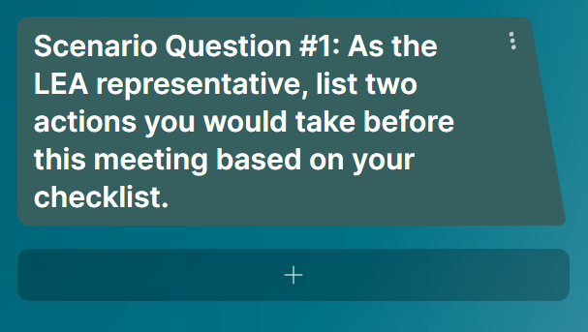

Scenario
Respond to Scenario Question #1 on the Padlet.
Take a few moments to look at the Padlet and see how others responded to this scenario.
In the chat, type one or two words that resonate with you.

Slide 32
IDEA Considerations for Student Transfers
Comparable services must be similar in type, frequency, and intensity to those in the previous IEP
Under IDEA, when a student with an IEP transfers to a new district, the new school must provide comparable services
For out-of-state transfers, comparable services are provided until evaluations (if needed) are completed and a new IEP is developed
For in-state transfers, comparable services are provided until the new district adopts the existing IEP or develops a new one
Source: IDEA 34 C.F.R. §300.323(e)–(f)

Slide 33
During the IEP Meeting: Meeting Facilitation Strategies
Use strengths‑based and people-forward language: Keep the discussion focused on the student's strengths (e.g., developing grade-level skills with supports, benefiting from predictable routines, etc.).
Manage the Meeting: Ensure meeting follows an agenda, meaningful participation from all members of the IEP team, and LEA resources are allocated.
Be transparent and responsive to families: Ensure that families feel informed and included throughout the meeting.
Anchor the meeting in student data: Use data to clarify the student's needs and guide the discussion.
Use conflict prevention strategies when needed: Employ conflict‑prevention techniques (e.g., ask clarifying questions, summarize concerns, offer options, etc.).

Slide 34
Meeting Readiness Checklist
During
Model strengths-based and people-forward language.
Be transparent and responsive to team members’ feedback and requests.
Keep discussion anchored in student data.
When necessary, utilize best practices for conflict management
(e.g., redirect team, manage disagreement).
Approve resource allocation.
Support the case manager in following the agenda, monitoring time, summarizing information, and outlining action steps.
Support the IEP team in engaging family members in the IEP development process.
Adapted from The Ability Challenge's The LEA Representative: A Guide for School Leaders

Slide 35
Scenario: Jordan's Plan
General Education Teacher Input: Teachers report avoidance behaviors and difficulty with writing tasks. Jordan's engagement varies, and there is concern about dependence on adult support to complete tasks.
Special Educator Input: The special educator notes that goals are vague, accommodations from the prior school were inconsistent, and a functional behavioral assessment may be needed.
System Context: Meeting Jordan's needs is a top priority. Your building is experiencing staffing shortages. You are tasked with supporting the IEP team's review and possible revision of his IEP. You have reached out to the special education director, and she reminded you to focus on designing an IEP meet his needs, and then the district will decide how to support the implementation.
Meeting Outcome: The IEP team agreed that 1:1 support isn't needed at this time. Jordan's team added goals to address the task avoidance and writing needs. You agreed to follow up with Jordan's mom 3 weeks after the meeting to discuss his progress with the new goals and supports.
Respond to Scenario Question #2 in the Padlet: How does the additional information above change how you would prepare for the meeting?

Slide 36
Slide 37
High‑quality IEPs depend on prepared LEA representatives who understand their authority, use data intentionally, and lead collaborative decision‑making.

Slide 37
After the IEP Meeting: Post-meeting
Follow-Through
Confirm IEP implementation plans with case manager: Ensure that services and supports are clearly defined and ready to implement.
Verify staff communication of IEP services: Confirm that the case manager has communicated expectations to all relevant staff including assigned responsibilities and next steps.
Ensure family communication: Confirm that families understand services, supports, and next steps.

Slide 38
Meeting Readiness Checklist
After
Confirm service implementation plans with the case manager.
Confirm that the case manager has communicated IEP services and supports with staff.
Ensure that the IEP implementation plan has been communicated with the family.
Meet regularly with the case manager to review IEP implementation and the student's progress.
Adapted from The Ability Challenge's The LEA Representative: A Guide for School Leaders

Slide 39
Scenario: Jordan's Plan
In the chat, share additional steps the LEA representative could take to ensure follow-through and implementation after the meeting.
After the meeting, the LEA representative reviewed the team's decisions to ensure that the IEP accurately reflected the discussion about Jordan's independence, daily check‑ins, and the determination that a 1:1 aide was not needed at this time. They confirmed that new goals addressing task avoidance and writing were added and communicated these updates to the appropriate staff for implementation. The LEA representative also documented the plan to follow up with Jordan's mother in 3 weeks to review his progress with the new supports.

Slide 40
Application and Reflection Activity
Independent Activity

Slide 41
Strategies Review
Preparation strategies
Meeting facilitation strategies
Postmeeting follow-through

Slide 42
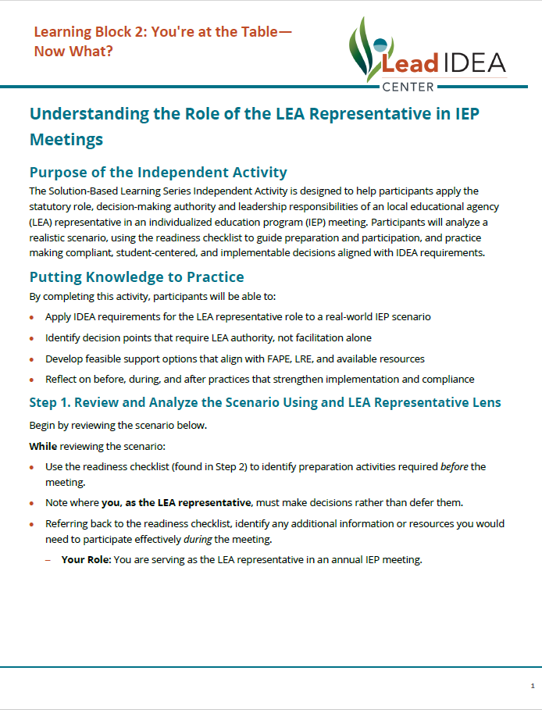
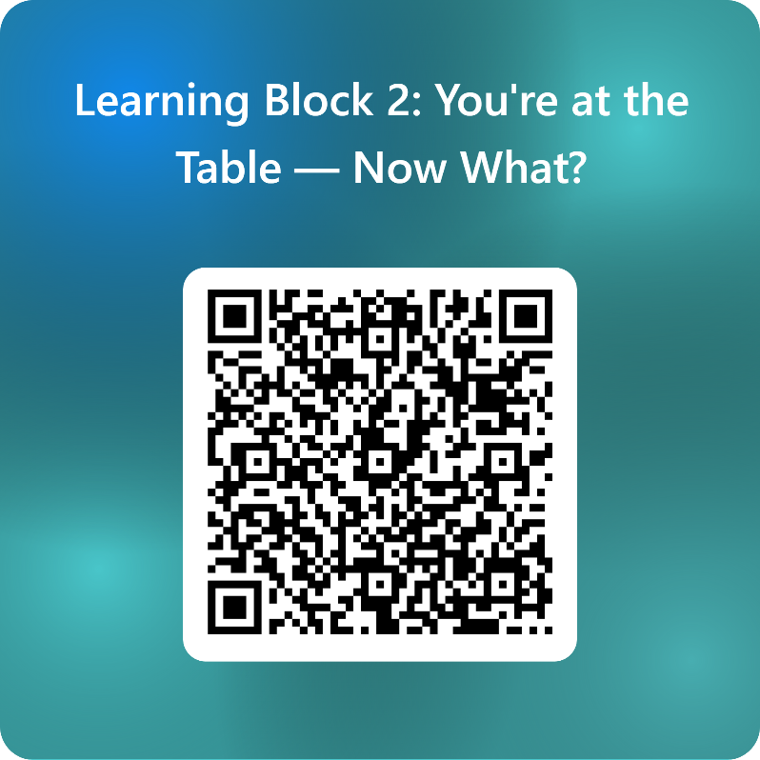
Scenario and Reflection Activity
Learning Block 2: You're at the Table — Now What? – Fill out form

Slide 43
Scenario: Ella Jones
Your Role: You are serving as the LEA representative in an annual IEP meeting.
Ella Jones is a 1st-grader with an intellectual disability associated with Down syndrome. This is Ella's first annual IEP review at the elementary level. Ella is described as warm, social, and eager to please. She is a strong visual learner who benefits from predictable routines, hands‑on activities, and meaningful inclusion with peers. Her primary needs include receptive and expressive language development, foundational academic skills, and support for inclusion with classmates.

Slide 44
Scenario: Ella Jones
Family Request: Ella’s parents are requesting full inclusive setting, with same-aged nondisabled peers supported by a 1:1 paraprofessional for academics, communication, and transitions. They are also requesting increased speech and occupational therapy services.
General Education Teacher Input: The general education teacher notes Ella's friendliness and enjoyment of group activities. The teacher also reports that Ella needs significant prompting to follow multistep directions and becomes frustrated when tasks are too complex or paced too quickly.
Special Educator Input: The special educator shares that Ella requires a modified curriculum and explicit and systematic instruction in foundational skills. According to the data, Ella responds well to visual schedules, repetition, modeling, and small-group instruction. Additional support may be needed during transitions, fine-motor activities, and when communication issues arise. However, given the extent of the adaptations required, the special educator believes some supports would be most effectively delivered in a special education setting. The special educator recommends goals that focus on communication, functional academics, and adaptive skills.
System Context: Meeting Ella’s needs is a top priority. The district is committed to inclusive practices and uses evidence-based decision-making rather than preference-based supports. There is limited availability of 1:1 paraprofessionals, and balancing family expectations with feasible staffing models is a consideration for the IEP team.

Slide 45
Scenario: Ella Jones
Meeting Outcomes: The IEP team conducted a comprehensive review of the data gathered throughout Ella's initial year at the elementary level, carefully considering the family's request for full inclusion and dedicated 1:1 support. With input from educators and related service providers, the team reached a consensus to prioritize peer inclusion during nonacademic activities and established updated goals in the domains of communication, foundational academics, and adaptive skills. It was decided that targeted support would be implemented during transitions, fine-motor tasks, and instances of communication breakdowns, as opposed to continuous 1:1 support. Additionally, the IEP reflects recommendations for additional speech and occupational therapy services.

Slide 46
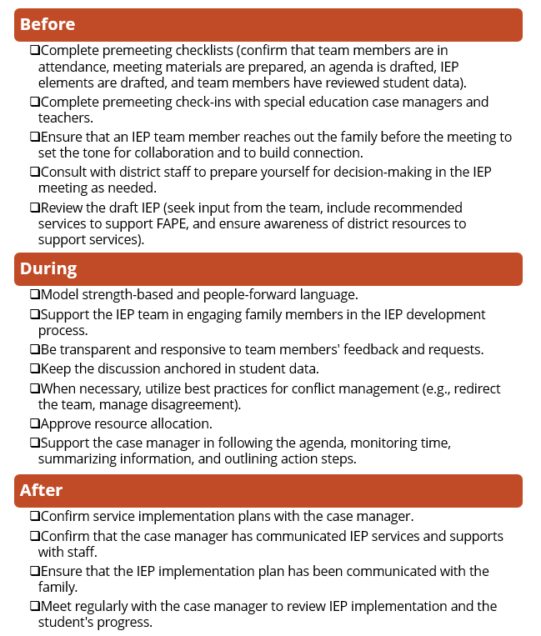

Let's Apply Our Learning to the Scenario
Use the strategies we discussed and the readiness checklist as a resource.
  Step 1: Review the readiness checklist for key considerations. Highlight which strategies you will focus on as you prepare to complete Step 2.
  Step 2: Create two realistic, feasible, and compliant support options for this student that do not require the district to immediately assign a full-time 1:1 paraprofessional.
  Step 3: Enter the strategies that you used and the support options you created into the Microsoft Form.

Slide 47
Meeting Readiness Checklist
Before
Complete premeeting checklists (confirm that team members are in attendance, meeting materials are prepared, an agenda is drafted, IEP elements are drafted, and team members have reviewed student data).
Complete premeeting check-ins with special education case managers and teachers.
Ensure that an IEP team member reaches out to the family before the meeting to set the tone for collaboration and to build connection.
Consult with district staff to prepare yourself for decision-making in the IEP meeting as needed.
Review the draft IEP (seek input from the team, include recommended services to support FAPE, and ensure awareness of district resources to support services).
Adapted from The Ability Challenge's The LEA Representative: A Guide for School Leaders

Slide 48
Meeting Readiness Checklist
During
Model strength-based and people forward language.
Be transparent and responsive to team members’ feedback and requests.
Keep discussion anchored in student data.
When necessary, utilize best practices for conflict management
(e.g. redirect team, manage disagreement).
Approve resource allocation.
Support the case manager in following the agenda, monitoring time, summarizing information, and outlining action steps.
Support the IEP team in engaging family members in the IEP development process.
Adapted from The Ability Challenge's The LEA Representative: A Guide for School Leaders

Slide 49
Meeting Readiness Checklist
After
Confirm service implementation plans with the case manager.
Confirm that the case manager has communicated IEP services and supports with staff.
Ensure that the IEP implementation plan has been communicated with the family.
Meet regularly with the case manager to review IEP implementation and the student's progress.
Adapted from The Ability Challenge's The LEA Representative: A Guide for School Leaders

Slide 50
Closing and Next Steps

Slide 51

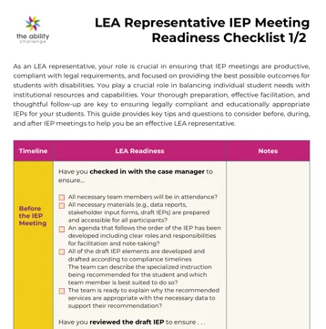
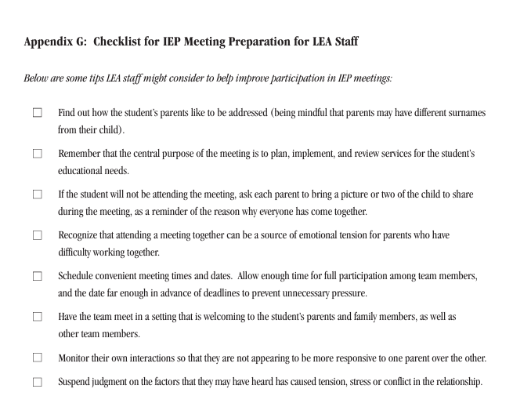


Strategies to Address Challenges: Resources
The Ability Challenge: LEA Representative Meeting Readiness Checklist
CADRE: In The Best Interests of the Child: IEP Meetings When Parents Are In Conflict

Slide 52
Supports to Consider for LEA Representative’s Success
Create an LEA representative IEP meeting readiness checklist
Develop Decision‑making flowcharts
Create IEP meeting facilitation scripts
Provide coaching or shadowing opportunities for new designees

Slide 53
Solution-Based Learning Series: Next Steps
April 9, 2026 | Independent Work | April 23, 2026
Virtual Session |  | Virtual Session
Knowledge Development Session 75 minutes 6:00–7:15 p.m. ET |  | Reflection Session 60 minutes 6:00–6:45 p.m. ET

Slide 54
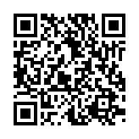
Mid-Series Pulse Check Survey
Please share your thoughts and experience with us!
Take 3 minutes to complete our SBLS: Learning Block 2 Mid-Series Pulse Check Survey
Survey Link: https://www.research.net/r/LeadIDEA_SBLS_040926_Participant

Slide 55
Certificate Requirements
Participants who complete the following criteria will receive a certificate:
  Attend 75% or more of each session.
  Complete the independent activity by submitting the Microsoft Form.
  Complete the learning block evaluation at the end of the next session.

Slide 56

What is on your mind?

Slide 57

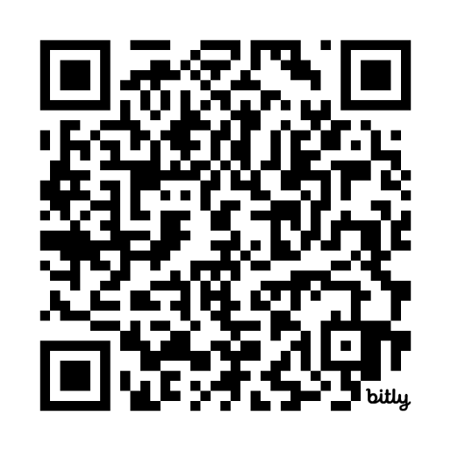
Connect With the Lead IDEA Center
Visit Our Website:
https://lead-idea.org

Slide 58




Stay Up to Date on All Lead IDEA Center Happenings
Subscribe to our newsletter:
Follow us on social media:
@leadideacenter
@Lead IDEA Center

Slide 59
Contact Us
XXX-XXX-XXXX
LeadIDEA@air.org
1400 Crystal Drive, 10th Floor
Arlington, VA 22202-3289
202.403.5000
https://www.air.org/centers/lead-idea-center
This material was produced under the U.S. Department of Education, Office of Special Education Programs, Award No. H325Z230007. David Emenheiser serves as the project officer. The views expressed herein do not necessarily represent the positions or policies of the U.S. Department of Education. No official endorsement by the U.S. Department of Education of any product, commodity, service, or enterprise mentioned on this website is intended or should be inferred.
30057_04/26

