Slide 1
Welcome to the Lead IDEA Solution-Based Learning Series
Learning Block 3: Leading Part C Service Delivery: From Oversight to Coherent,
High-Quality Practice
May 21, 2026
This material was produced under the U.S. Department of Education, Office of Special Education Programs, Award
No. H325Z230007. Anna Macedonia serves as the project officer. The views expressed herein do not necessarily represent the positions or policies of the U.S. Department of Education. No official endorsement by the U.S. Department of Education of any product, commodity, service, or enterprise mentioned on this website is intended or should be inferred.

Slide 2
Agenda
1
Welcome to the Lead IDEA Solution-Based Learning Series
2
IDEA Foundations: Legal Responsibilities
3
Common Challenges to Part C Delivery
4
Strategies to Address Challenges and Ensure High-Quality Practice
5
Application and Reflection Activity
6
Independent Activity and Next Steps

Slide 3
Today's Norms
Honor Strengths and Differences: Recognize and value the experiences, perspectives, and expertise participants bring to the table.
Engage Actively and Respectfully: Listen with intention, speak with purpose, and contribute constructively to foster a collaborative environment.
Assume Positive Intent: Approach discussions with curiosity and compassion to promote a safe space for learning and sharing.
Stay Solution-Focused: Prioritize actionable feedback and ideas that support continuous improvement of tools and understanding of the Individuals with Disabilities Education Act (IDEA).
Share the Mic: Balance participation to ensure that all voices are heard
and valued.

Slide 4
Goal
By the end of this learning series, participants will be able to
Clarify the responsibilities of early intervention (EI) program leaders in supporting Part C service delivery;
Examine leadership practices that strengthen and support Part C service providers, teams, and community partners in delivering high-quality services in home and/or community-based settings for eligible infants and toddlers and their families; and
Identify leadership approaches for engaging and partnering with families to ensure that services reflect family priorities, cultural contexts, and strengths.

Slide 5
Goal of Learning Block
The goal of the Lead IDEA Solution‑Based Learning Series Learning Block 3 is to strengthen local EI administrators’ leadership skills to provide high-quality, coordinated service delivery.

Slide 6




The Lead IDEA Center: What We Do
Through partnerships with states, districts, and other leadership networks, we implement and scale leadership development that equips EI and school building administrators with the essential IDEA leadership knowledge and skills needed to:
Enhance workforce effectiveness
Improve working conditions and culture
Strengthen special education/EI programming
Promote progress and belonging for all children
Understand and Comply With IDEA Requirements

Slide 7


Meet the Lead IDEA Presenters
Mary Beth Bruder
Maureen Greer
Lead IDEA Co-Principal Investigator
UConn Health
Center for Excellence in Developmental Disabilities
Lead IDEA Advisor
Emerald Consulting

Slide 8
Why This Matters Now
The population of children eligible for EI services continues to grow in diversity
and complexity.
Families have a variety of priorities and needs.
EI services are delivered by providers who represent different disciplines
and experiences.
Funding is often insufficient to meet the needs of eligible children and families.

Slide 9
What’s Impacting High-Quality Leadership?
Zoom Poll: What stressor most impacts your ability to provide effective, high-quality leadership?
(Responses will be collected through a Zoom poll. The poll will appear momentarily.)
  Insufficient state funding?
  Increasing number of referrals?
  Lack of providers?
  State oversight challenges?
  Lack of administrative support?
  Changing family complexities?

Slide 10
IDEA Foundations:
Legal Responsibilities

Slide 11
IDEA Requirements for Part C Service Delivery
IDEA Part C lays out specific federal requirements for how EI services must be delivered to infants and toddlers with disabilities and their families.
Services based on an IFSP
34 CFR §§303.340–303.346)
Services provided in natural environments
34 CFR §303.26 and §303.126
Timely service delivery
34 CFR §303.310
Service coordination
34 CFR §303.34 and §303.344(g)
Services delivered by qualified personnel
34 CFR §303.31 and §303.119
Interagency coordination
34 CFR §§303.120, 303.302, 303.303, 303.511
Transition planning
34 CFR §303.209
General supervision
and quality monitoring
34 CFR §§303.120, 303.700–303.702
Multidisciplinary evaluation and assessment
34 CFR §303.321
Note. IFSP = individualized family service plan.

Slide 12
How Are Local EI Program Leaders Accountable?
Ensuring high-quality service delivery
System entry
Development and implementation of an IFSP for each enrolled child
Transition out of early intervention
Conducting activities including child find, referral, evaluation, and assessment through eligibility determination
Developing an individualized family service plan (IFSP) that addresses the priorities of the family and meets the service needs of the eligible child and family
Hiring staff who meet state-established personnel standards and providing continuing professional development opportunities
Beginning transition conversations at the first IFSP until the infant or toddler leaves the Part C system to move either to preschool special education or to other early childhood programming

Slide 13
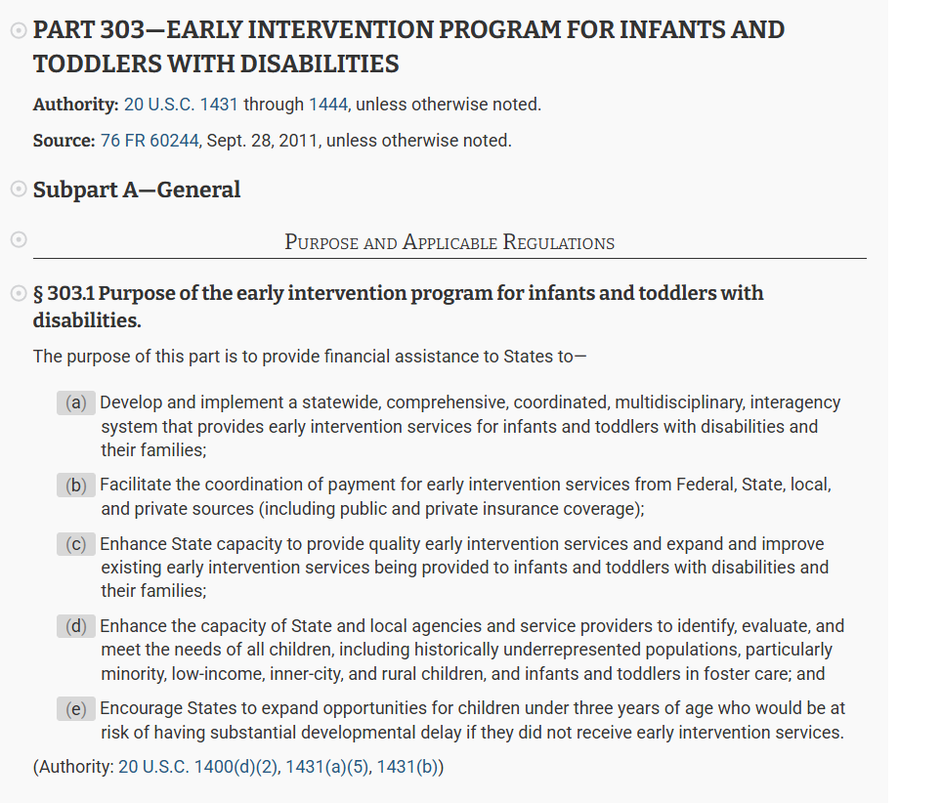



Resources
Required Statewide System Components
Developing High-Quality, Functional IFSP Outcomes and IEP Goals

Slide 14
Common Challenges to Part C Delivery

Slide 15
The Leadership Challenge
Ensuring high-quality services that improve child and family outcomes
Building system coherence across programs, providers, and settings
Leading family-centered, team-based implementation
Securing and allocating fiscal resources to support service delivery

Slide 16
The Reality
Providers operate across multiple programs and systems, creating potential fragmentation
Training and technical assistance efforts happen outside direct oversight, often limiting consistency across programs/providers
Service providers often have limited access to ongoing professional learning

Slide 17
Activity
Ensuring high-quality services
Building system coherence
Leading family-centered, team-based implementation
Securing and allocating fiscal resources
Zoom Poll: Which responsibility do you spend most of your time on?
(Responses will be collected through a Zoom poll. The poll will appear momentarily.)

Slide 18
Goal of Learning Block
Leadership impact isn’t about doing more—it’s about being more intentional with what you already do.

Slide 19
Strategies to Address Challenges and Ensure
High-Quality Practice
EI Program Administrator Actions

Slide 20
Leadership Practices to Strengthen and Support Service Delivery
Align providers around a shared vision and purpose
Establish clear, consistent expectations across settings and roles
Champion the use of evidence-based practices in program implementation
Leverage data continuously to guide decisions and drive improvement

Slide 21
Practices for Leading Quality Service Delivery
Set clear expectations for family-centered practice
Build structures that support providers
Strengthen cross-agency collaboration
Use data and feedback to guide improvements

Slide 22
Partnering With Families as a Leadership Practice
Ensure services reflect family priorities
Respect cultural backgrounds and preferences
Use family strengths to guide decision making
Engage families as partners

Slide 23
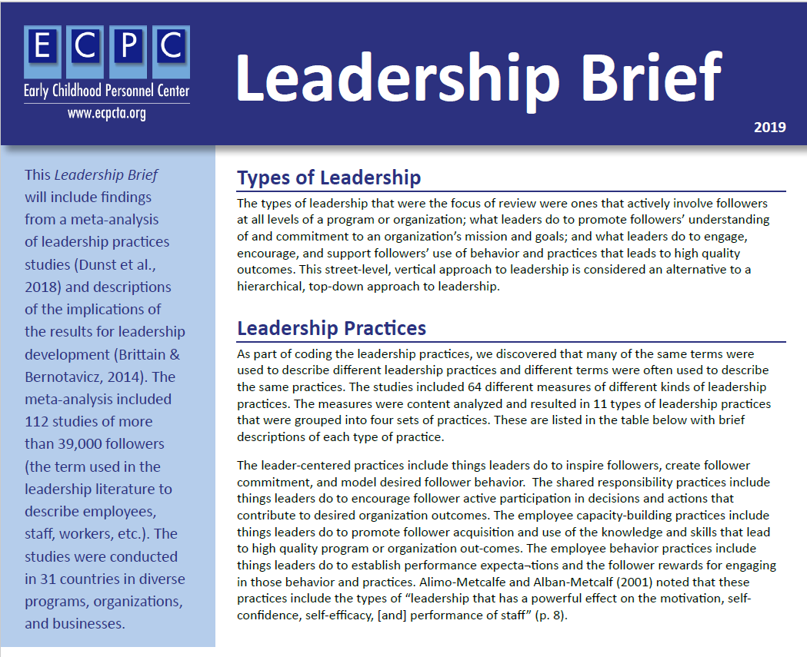
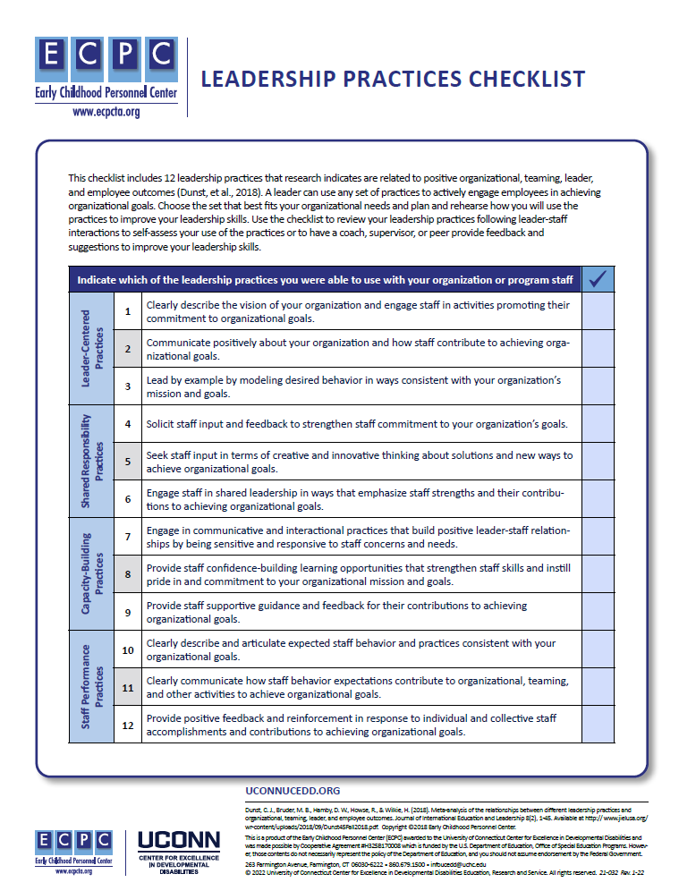
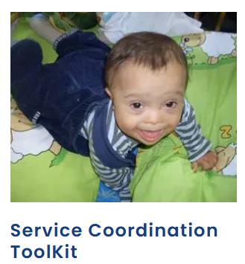



Resources
Leadership Brief
Leadership Practices Checklist
Family Service Coordination Toolkit

Slide 24
Application and Reflection Activity

Slide 25
Scenario: From Compliance to Coherence
You are the director of a local intervention program serving a geographically and culturally diverse community.
The program contracts with multiple providers, and
services are delivered primarily in natural environment.
Recent monitoring data show that the program is meeting most compliance timelines, but several concerns have emerged:

Slide 26
Scenario: From Compliance to Coherence
Families report inconsistent experiences across providers, particularly related to how family priorities are identified and incorporated into IFSP outcomes.
Providers express confusion about expectations for family-centered practices, especially when working with families whose cultural values differ from their own.
Community partners (e.g., childcare, health clinics, family resource centers) report limited coordination with EI, leading to fragmented services.
Family representatives on the local Interagency Coordinating Council have raised concerns that family voice is often “consulted” but not meaningfully reflected in decisions.

Slide 27
Scenario: From Compliance to Coherence
At the same time, staff turnover has increased, and providers report limited access to coaching, reflective supervision, and professional learning opportunities.
As the local program leader, you are accountable for high-quality Part C service delivery, not just compliance. Although you cannot directly observe most services, you can influence individual provider practices.
You must decide how to shift from management to leadership by strengthening system conditions that support:
Consistent, family-centered practices
across providers
Strong partnerships with families and
community partners
Clear expectations and supports for service
delivery in natural environments

Slide 28
Thoughts to Consider: Leadership Responsibilities
As the Part C leader in the scenario, what are your responsibilities related to the following:
  Service quality across multiple providers?
  Ensuring IFSPs reflect family priorities, culture, and strengths?
  Supporting implementation, not just development,
  of IFSPs?
In the chat, answer the following question.
Which of these responsibilities require system-level leadership rather than provider-level corrections?

Slide 29
Key Takeaways
EI leaders are accountable for quality, not isolated compliance
Leadership shapes how systems work, especially across partners
Family-centered practice depends on system conditions
Small leadership shifts drive large- scale improvement

Slide 30
Independent Activity and Next Steps

Slide 31

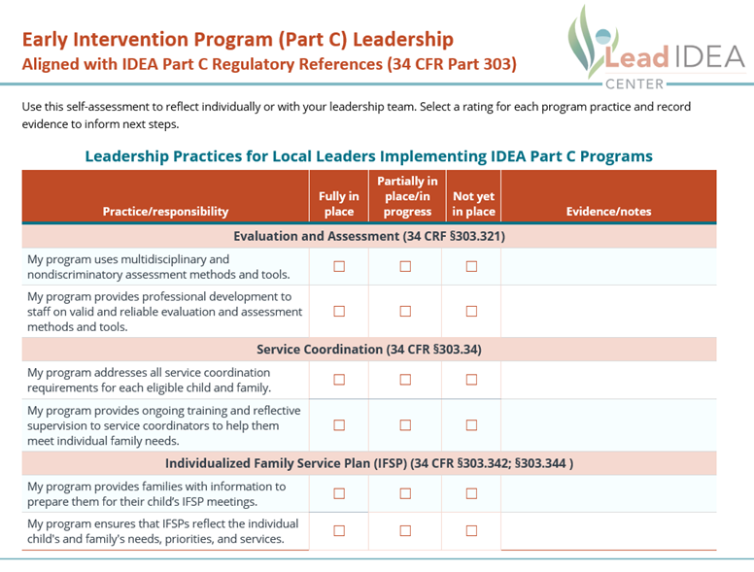
Independent Activity
Learning Block 3 Activity: Clarifying Leadership Responsibilities Across Service Delivery

Slide 32
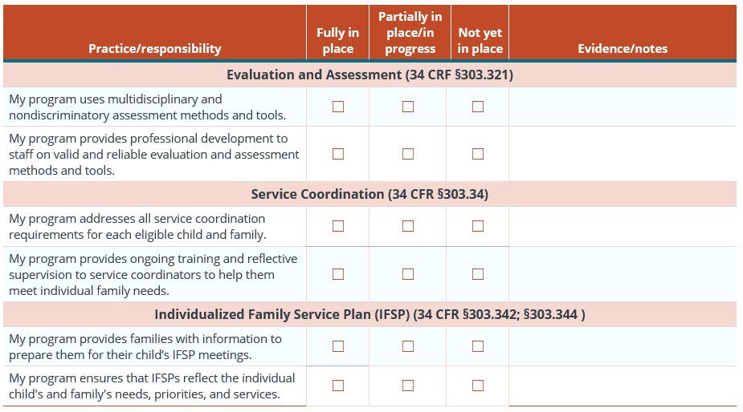
Leadership Practices for Local Leaders Implementing Part C Programs

Slide 33
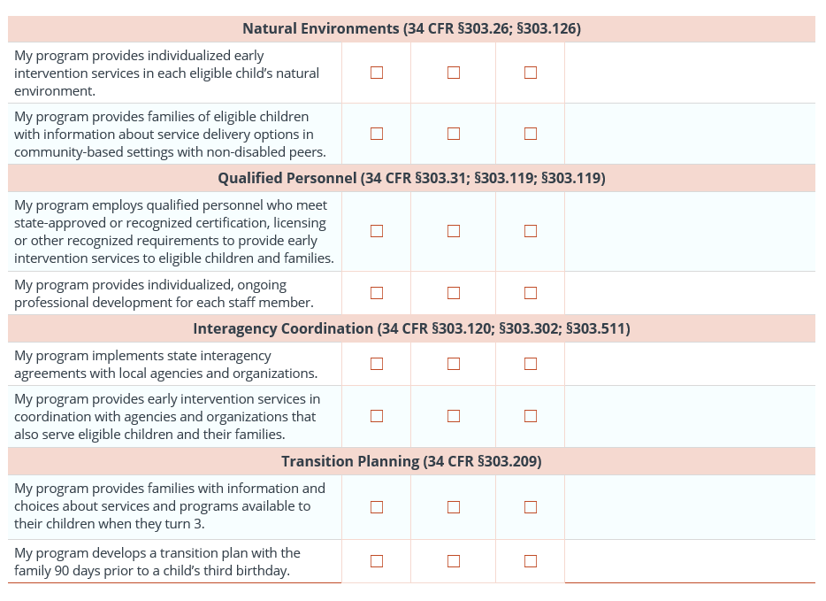
Leadership Practices for Local Leaders Implementing Part C Programs (Cont.)

Slide 34
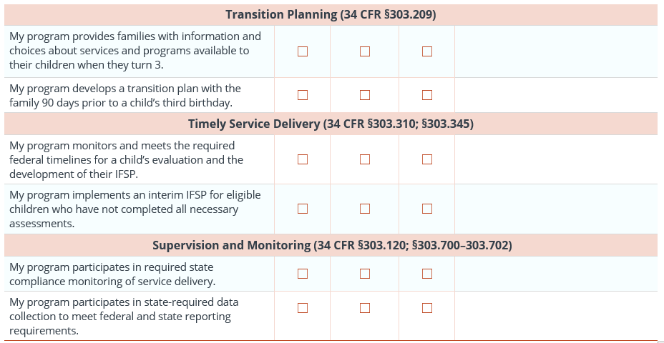
Leadership Practices for Local Leaders Implementing Part C Programs (Cont.)

Slide 35
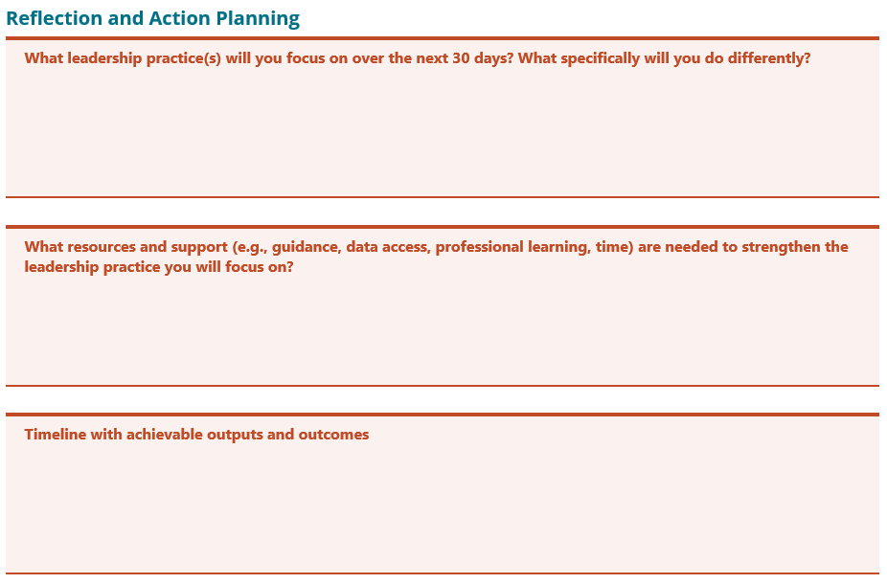
Leadership Practices Reflection

Slide 36
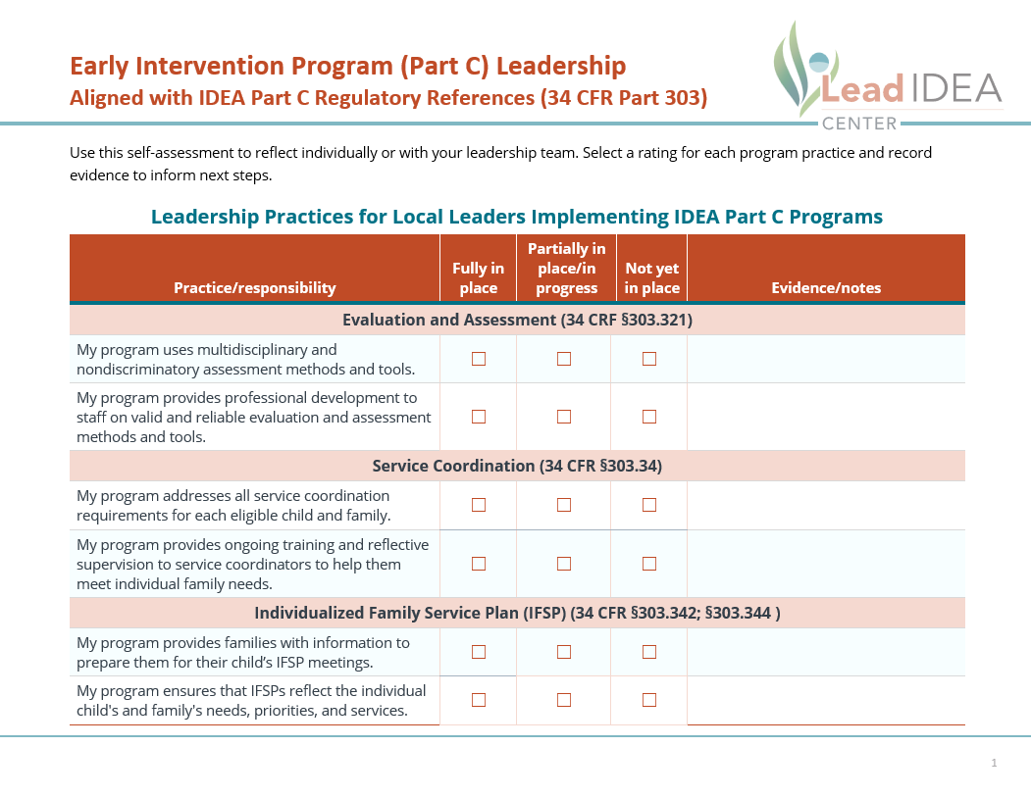

Let's Apply Our Learning
Consider the strategies we discussed and the leadership checklist as a resource.
  Step 1: Review and complete the leadership checklist, noting evidence where applicable.
  Step 2: Complete the Reflection and Action Planning section.
  Step 3: Upload the completed form using the link provided.

Slide 37
Next Steps
Complete the independent activity and submit the form before the Reflection Session on June 4.
  Identify one leadership action to influence service quality.
  Consider how to strengthen alignment across providers and partners.
  Continue the conversation with peers.

Slide 38

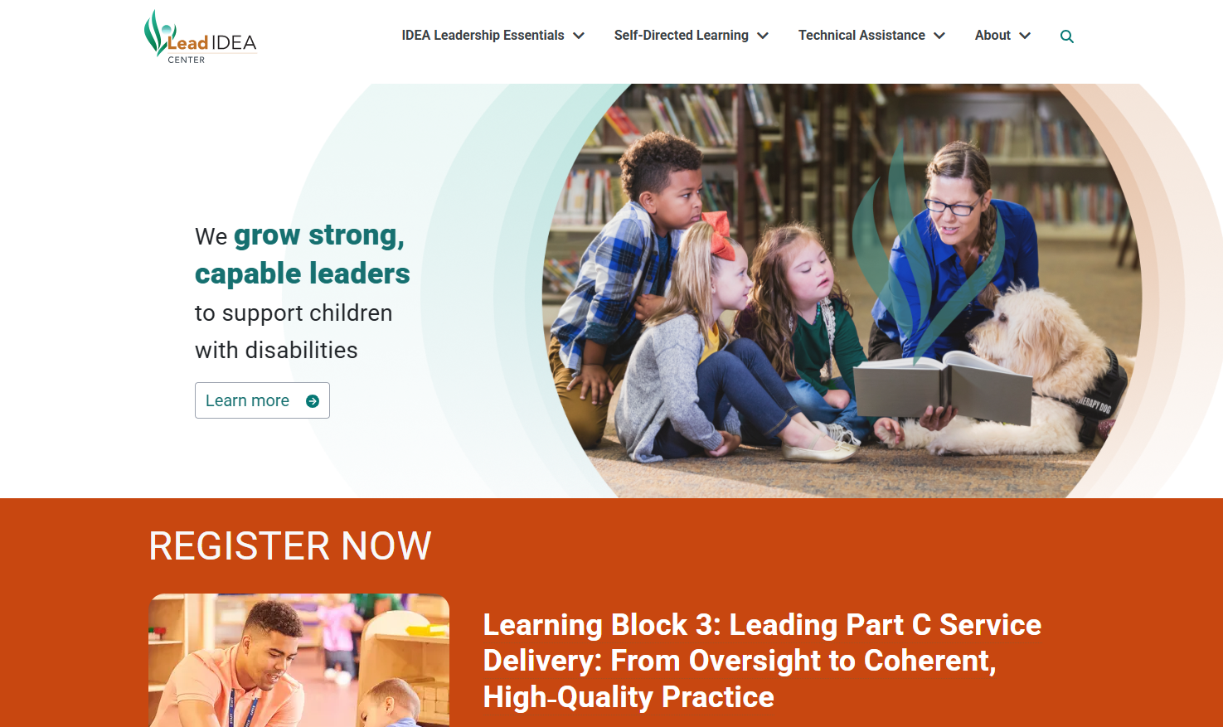

Connect With the Lead IDEA Center
Visit Our Website:
https://lead-idea.org

Slide 39




Stay Up to Date on All Lead IDEA Center Happenings
Subscribe to our newsletter:
Follow us on social media:
@leadideacenter
@Lead IDEA Center

Slide 40
Contact Us
LeadIDEA@air.org
1400 Crystal Drive, 10th Floor
Arlington, VA 22202-3289
202.403.5000
https://www.air.org/centers/lead-idea-center
This material was produced under the U.S. Department of Education, Office of Special Education Programs, Award No. H325Z230007. David Emenheiser serves as the project officer. The views expressed herein do not necessarily represent the positions or policies of the U.S. Department of Education. No official endorsement by the U.S. Department of Education of any product, commodity, service, or enterprise mentioned on this website is intended or should be inferred.
30347_05/26

